Slide 1



Notes:
Today we’re going to talk about adding magic and beauty to our apps, impressing our users

Slide 2
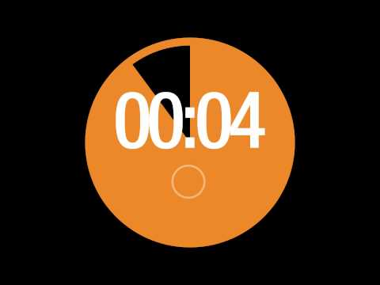
Notes:
Tying up the users to your app is the most important and yet one of the most puzzling parts of the app development. Studies have shown that users acquire a *very* strong impression about your app within the first 30''; Including of course splash screens or empty lists and loading indicators, that we’re all going to agree that are pretty much impossible to avoid in most of the apps.
That’s probably all the time you have to convince your user not only not to close your app but to also come back and prefer your app from another one. I’m not going to say that it’s easy, but I’d say “Try! Do NOT neglect those 30 precious seconds”’

Slide 3
Notes:
The whole idea of this presentation started from 2 apps:
The first one is called Google Playbook, which I recommend to give it a try if you haven't’ already; you can find some great articles in there. (click)
I was *impressed* on how a completely empty screen can NOT look boring but instead joyful, interesting and prompting on the same time!
I could bet that if everyone here designed that same screen, at least 70% of the designs would look something like that. (change slide)

Slide 4
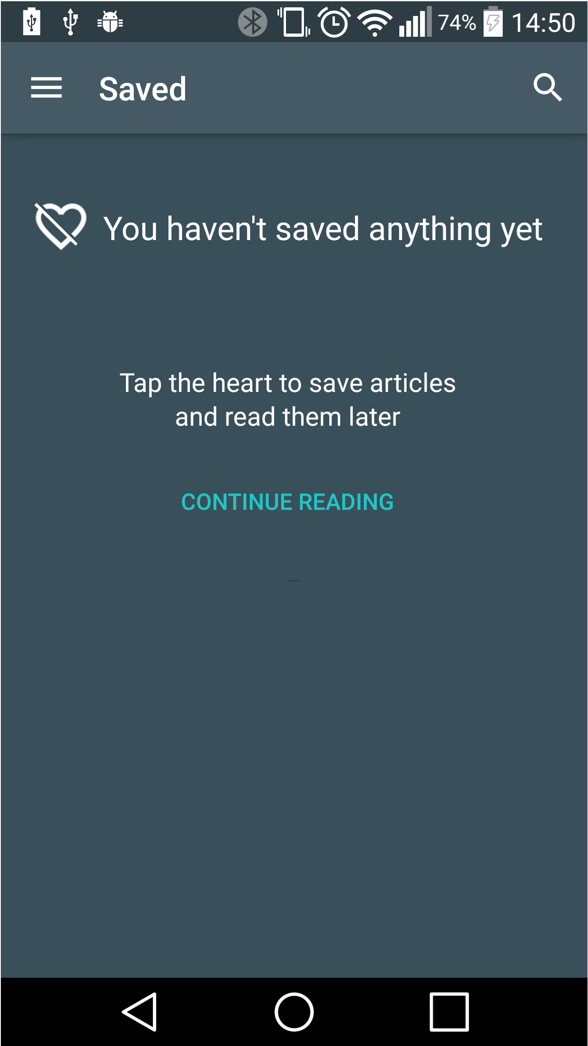
Notes:
Perhaps slidely better than this. If it’s worst you really have to read some design articles!
But still… it’s DULL! It’s bo-ring. No one is impressed by that

Slide 5
Notes:
The second app I was telling you about is called fabulous. (vid)
Let’s see the first thing the user sees: a splash screen. And you may wonder, is all this useful or is it too much work for nothing?! Although it may seem “too work for nothing” take a moment to rethink about that. Even if you had zero interest when you opened the app, it grabs your attention! It’s different, it’s beautiful; It is impressing you even if you don’t realize it.
And you just made a splash screen working not only for your app -to load all of your data, but also for your user, who simply doesn’t realize that it took him or her almost 15 seconds to open your app because he doesn’t see a static logo or an annoying loader indicator.
Pay also attention to how the icons appear and their motion. First the background of the icon is swiping to the left and then the colored part.

Slide 6
Motion
Notes:
This is the key word you need to add to your android dictionary, if you haven't’ already and focus on.
There are multiple ways you can add motion to your app and make it come alive using the different Android's animation APIs.

Slide 7

4 Questions
Where did the current view come from?
Where did the previous go?
What did I click?
Where did the current view come from?
Where did the previous go?
What did I click?
Where can I go next?
Where did the current view come from?
Where did the previous go?
What did I click?
Where can I go next?
Where did the current view come from?
Where did the previous go?
Notes:
Animations need to be smooth, and follow some basic physics so it looks normal to your eye. They exist to give users feedback on their actions and provide visual continuity as they interact with your app.
Therefore, there are 4 questions you need to ask yourself when animating anything in your app. If you can answer these questions by watching your animation, you’re good to go
There are great examples in many apps you use every day like this for instance :

Slide 8
CAUTION!
Notes:
Any animated object will instantly capture your user’s eye at that point, so be careful that
Your animation won’t distract your user
You’re not blocking him from performing an action while an animation is playing

Slide 9
android.view.animation
The Animation.class
AlphaAnimation
AnimationSet
RotateAnimation
ScaleAnimation
TranslateAnimation
<?xml version="1.0" encoding="utf-8"?>
<rotate
xmlns:android="http://schemas.android.com/apk/res/android"
android:duration="1000"
android:fromDegrees="0"
android:pivotX="50%"
android:pivotY="50%"
android:toDegrees="360" />
<-- at the button's OnClickListener -->
Animation rotateAnimation =
AnimationUtils.loadAnimation(getApplication(), R.anim.rotate);
view.startAnimation(rotateAnimation);
...
final RotateAnimation animation = new RotateAnimation(0, 360,
Animation.RELATIVE_TO_SELF, .5f,
Animation.RELATIVE_TO_SELF, .5f);
animation.setDuration(500);
...
<-- at the button's OnClickListener -->
Animation rotateAnimation = view.startAnimation(animation);
final AnimationSet animationSet = new AnimationSet(true);
animationSet.addAnimation(rotateAnimation);
animationSet.addAnimation(alphaAnimation);
<-- at the button's OnClickListener -->
Animation rotateAnimation = view.startAnimation(animationSet);
Notes:
Starting from the oldest ones, let’s see the View animations, which is the set of APIs that are available prior to Honeycomb 3.0.
The Animation class has 5 known subclasses.
Alpha animation will fade in or out your object.
AnimationSet represents a group of Animations that should be played together. The transformation of each individual animation are composed together into a single transform.
Rotate animation, guess what.. It will rotate your object
With the scale animation you can scale up or down your object
And finally with translate you can move it
Let’s see an example of that : There are 2 ways to add an animation. First one is by creating an xml file with the animation you want. Like this (change slide). Or we can add it programmatically like this (change slide) [pivotx and y is the center of the rotation]
And let’s also see an example for AnimationSet : Let\s assume that we have already declared 2 animation, a rotation and an alpha animation. The outcome is this : (change slide)
[the boolean parameter is for sharedInterpolator. We pass true if all of the animations in this set should use the interpolator associated with this AnimationSet, or false if each animation should use its own)

Slide 10
Property Animation API
Notes:
Introduced on HoneyComb 3.0, Properties Animation API was the first “real” animation API to see.
It makes it easy to animate any kind of property on any object by allowing you to define a start and end value and apply a time-based change on this attribute. What is super awesome about this API, is that it can be applied on any Java object not only on Views, while prior to HoneyComb you could animate Views and that’s it.
[eg. menu drawable]

Slide 11
android.animation
The Animator.class
AnimatorSet
ValueAnimator
ObjectAnimator
TimeAnimator
Notes:
This is the superclass for classes which provide basic support for animations which can be started, ended, and have AnimatorListeners attached 9to them.
These classes are:
Animator set: This class plays a set of Animator objects in the specified order more or less as the AnimationSet class we saw earlier. That said, the animator set is more flexible and animations can be set up to play together, in sequence, or after a specified delay. In addition you can set it to play different animations on different objects and not just on the same one.
ValueAnimator : This class provides a simple timing engine for running animations which calculate animated values and set them on target objects. There is a single timing pulse that all animations use. It runs in a custom handler to ensure that property changes happen on the UI thread.
ObjectAnimator : provides support for animating properties on target objects
TimeAnimator : provides a simple callback mechanism to listeners that is synchronized with all other animators in the system. There is no duration, interpolation, or object value-setting with this Animator. Instead, it is simply started, after which it proceeds to send out events on every animation frame to its TimeListener (if set), with information about this animator, the total elapsed time, and the elapsed time since the previous animation frame.
When animating properties there are 2 steps: calculating the animated values and setting those values on the object and property in question. ValueAnimator takes care of the first part; calculating the values, while the ObjectAnimator class,, is responsible for setting those values on target objects.
Let’s have a closer look to ValueAnimator first.

Slide 12
ValueAnimator.class
ValueAnimator valueAnimator = ValueAnimator.ofInt(0,100);
valueAnimator.setDuration(1000);
valueAnimator.start();
…
…
valueAnimator.addUpdateListener(new ValueAnimator.AnimatorUpdateListener() {
@Override
public void onAnimationUpdate(ValueAnimator valueAnimator) {
int value = (int) valueAnimator.getAnimatedValue();
}
});
Notes:
Animators can be created from either code or resource files.
This one for example will animate values between 0 and 100 in one second; the parameter could also be a float or color. Of course, if you don’t do anything with these values that’s pretty much useless as, as we said, ValueAnimator only calculates the values and doesn’t assign them to an object.
So you add a listener to it, to listen for updates at each frame. And when you get the callback, you call getAnimatedValue(), which returns an Object, to find out what the current value is
The other way to create it would be from an xml file like this :

Slide 13
ValueAnimator.class
<animator
xmlns:android="http://schemas.android.com/apk/res/android"
android:duration="1000"
android:repeatCount="1"
android:valueFrom="0"
android:valueTo="100"
android:valueType="intType" />
<!-- combining with PropertyValuesHolder -->
<animator xmlns:android="http://schemas.android.com/apk/res/android"
android:duration="1000"
android:repeatCount="1"
android:repeatMode="reverse">
<propertyValuesHolder>
<keyframe android:fraction="0" android:value="1"/>
<keyframe android:fraction=".2" android:value=".4"/>
<keyframe android:fraction="1" android:value="0"/>
</propertyValuesHolder>
</animator>
Notes:
It is also possible to use a combination of PropertyValuesHolder and Keyframe resource tags to create a multi-step animation.
PropertyValuesHolder holds information about a property and the values that that property should take on during an animation. Keyframes are the specific state of an animation at a specific time. A KeyFrame object consists of a time/value pair.
[Note that you can specify explicit fractional values (from 0 to 1) for each keyframe to determine when, in the overall duration, the animation should arrive at that value. Alternatively, you can leave the fractions off and the keyframes will be equally distributed within the total duration]

Slide 14
ObjectAnimator.class
ObjectAnimator objectAnimator = ObjectAnimator.ofFloat(btn, View.ROTATION, 360);
objectAnimator.setDuration(5000);
objectAnimator.setRepeatCount(1);
objectAnimator.setRepeatMode(ValueAnimator.REVERSE);
objectAnimator.start();
Notes:
ObjectAnimator is probably the main class that you will use in PropertyAnimations. You use it to construct animations with the timing and values that ValueAnimator takes, and also give it a target object and property name to animate.
That said, we use the ObjectAnimator if we’re only going to animate one or two properties of a View object. If we want to animate a number of properties at the same time we use the ViewPropertyAnimator class that we’ll see later on.
As the ValueAnimator, the ObjectAnimator can be created either from code or from the xml.

Slide 15
ObjectAnimator.class
<objectAnimator
xmlns:android="http://schemas.android.com/apk/res/android"
android:duration="1000"
android:valueFrom="0"
android:valueTo="360"
android:valueType="floatType"
android:propertyName="rotation"
android:repeatCount="1"
android:repeatMode="reverse" />
<!-- at your Java class -->
ObjectAnimator objectAnimator = (ObjectAnimator) AnimatorInflater.loadAnimator(this, R.animator.object_animator);
objectAnimator.setTarget(btn);
objectAnimator.start();
Notes:
Object Animators can also be used in combination with PropertyValuesHolder as we saw with the ValueAnimators
[The system will first try to match the propertyName with any known animation class. The propertyName though can be anything we want. In that case we will need a getter and a setter to set the value in the form of set<propertyName>() and get<propertyName>(). Because the ObjectAnimator automatically updates the property during animation, it must be able to access the property with this setter method.]

Slide 16
ViewPropertyAnimator.class
btn.animate().rotation(360).setDuration(5000);
ViewPropertyAnimator propertyAnimator = btn.animate().rotation(360).setDuration(5000);
propertyAnimator.alpha(0f).setDuration(5000);
Notes:
ViewPropertyAnimator provides a simple way to animate several properties in parallel, using a single Animator internally. In addition it may provide better performance for several simultaneous animations, because it will optimize invalidate calls to take place only once for several properties instead of each animated property independently causing its own invalidation.
It also has a much simpler syntax. [change slide]
This line, will create the exact same animation to our button as the object animator. And if we had more animations added, it would look something like this..

Slide 17
Frame by frame animation
<animation-list xmlns:android="http://schemas.android.com/apk/res/android">
<item android:drawable="@drawable/frame1" android:duration="100" />
<item android:drawable="@drawable/frame2" android:duration="100" />
<item android:drawable="@drawable/frame3" android:duration="100" />
<item android:drawable="@drawable/frame4" android:duration="100" />
<item android:drawable="@drawable/frame5" android:duration="100" />
</animation-list>
<!-- at your Java class -->
imageView.setBackgroundResource(R.drawable.frame_by_frame_drawable);
AnimationDrawable animationDrawable = (AnimationDrawable) imageView.getDrawable();
animationDrawable.start();
Notes:
Frame animations are also known as Drawable animations. You define the Frame animation in XML and save it as a drawable. The animation is then displayed as a sequence of images in an image view.
[good for reusing drawables. Avoid if you have larger frames (fullscreen); you’re probably going to get an outOfMemory exception]

Slide 18
Layout animations - LayoutTransition.class
<LinearLayout
xmlns:android="http://schemas.android.com/apk/res/android"
xmlns:tools="http://schemas.android.com/tools"
android:id="@+id/container"
android:layout_width="match_parent"
android:layout_height="match_parent"
android:animateLayoutChanges="true"
tools:context="com.pixplicity.appmagic.MainActivity">
<!-- at your Java class -->
LayoutTransition layoutTransition = new LayoutTransition();
layoutTransition.enableTransitionType(LayoutTransition.CHANGE_APPEARING);
mLinearLayout.setLayoutTransition(layoutTransition);
Notes:
A layout animation is a pre-loaded animation that the system runs each time you make a change to the layout configuration. The LayoutTransition class enables automatic animations when items are added to or removed from a ViewGroup. To enable transitions for a layout container, we create a LayoutTransition object and we set it on any ViewGroup by calling setLayoutTransition(LayoutTransition).
[LayoutTransition.CHANGE_APPEARING : A flag indicating the animation that runs on those items that are changing due to a new item appearing in the container.]

Slide 19
Transition API
Notes:
This API provides a simple way for developers to provide animated segues to different scenes of their application, helping users to understand the application flow with very little code. The general approach is to tell the system that you'd like to run a transition animation, then make the necessary changes to your UI. The system figures out the differences and automatically animates the changes. It was introduced on Android Kitkat but is part of Support Library v24.2, supported back to API level 14

Slide 20
Scenes
<!-- activity_main.xml -->
<LinearLayout
xmlns:android="http://schemas.android.com/apk/res/android"
android:id="@+id/master_layout">
<FrameLayout
android:id="@+id/scene_root">
<include layout="@layout/a_scene"/>
</FrameLayout>
</LinearLayout>
<!--a_scene.xml-->
<RelativeLayout
xmlns:android="http://schemas.android.com/apk/res/android"
android:id="@+id/scene_container" >
<TextView android:id="@+id/text_view1" />
</RelativeLayout>
// at your java code
// Create the scene root for the scenes in this app
mSceneRoot =
(ViewGroup) findViewById(R.id.scene_root);
// Create the scenes
mAScene = Scene.getSceneForLayout
(mSceneRoot, R.layout.a_scene, this);
Scene mScene;
// Obtain the scene root element
mSceneRoot=(ViewGroup)mSomeLayoutElement;
// Obtain the view hierarchy to add as a child of
// the scene root when this scene is entered
mViewHierarchy=(ViewGroup)someOtherLayoutElement;
// Create a scene
mScene=new Scene(mSceneRoot,mViewHierarchy);
Notes:
First of all for most of the cases we need to create scenes.
Scenes store the state of a view hierarchy, including all its views and their property values. The transitions framework can run animations between a starting and an ending scene. The starting scene is often determined automatically from the current state of the user interface. For the ending scene, the framework enables you to create a scene from a layout resource file or from a group of views in your code
Scenes can be created either from layouts or from the code.

Slide 21
Transitions
// create transition from code
Transition mFadeTransition = new Fade();
<!--transition/fade_transition.xml-->
<fade xmlns:android="http://schemas.android.com/apk/res/android" />
<!-- at your Java code -->
Transition mFadeTransition = TransitionInflater.from(this).
inflateTransition(R.transition.fade_transition);
Notes:
Now that know how to make the scenes, we need to animate them
So we can either inflate a transition or we can create it with code like this

Slide 22
Transitions
TransitionManager.go(mEndingScene, mFadeTransition);
Notes:
And finally as we need to do is to apply the transition to our scenes.
The framework will change the view hierarchy inside the scene root with the view hierarchy from the ending scene while running the animation specified by the transition instance. The starting scene is the ending scene from the last transition unless there was no previous transition, so the starting scene is determined automatically from the current state of the user interface.
In other words let’s say that we had a viewgroup with a button, a textview and an imageview. If the end scene has the imageview on top and we had the transition applied it would slowly fade to it’s new position instead of just appearing and disappearing.

Slide 23
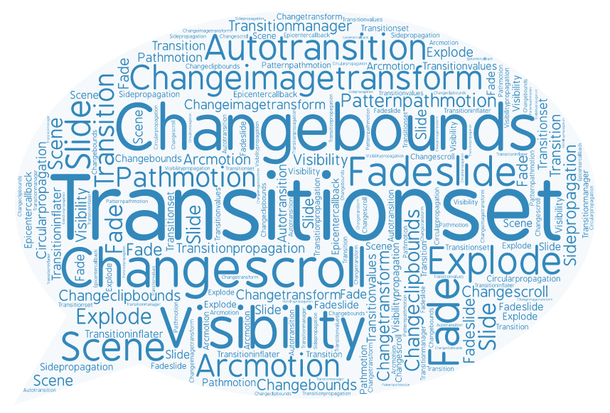
Android L : Custom animations
Touch feedback
Circular Reveal
Activity transitions
Curved motion
View state changes
... ... ...
Notes:
There is really so much to say about this, that it could be a whole new talk. Animations took a new meaning after the Material design was introduced to our lives. The new classes and APIs that were introduced are very well documented and I urge you to have a look on all of them and combine with all the classes and APIs that were referred before.
This talk was only scratching the surface of what you can do with and how you can combine all the animation APIs, but it’s impossible to include everything in just 40 minutes.
[https://developer.android.com/training/material/animations.html]

Slide 24



Thank
YOU!
Eliza Camberogiannis
elizacamber@gmail.com | @elizaCamber

